Slide 1


DWDM MINI PROJECT: Real Estate Domain
Made By:
PE21 Gauri Godghase
PE28 Aishwarya Gautam

Slide 2
Problem Definition
Predicting the House Prices in Bangalore City with the help of Housing Data.
The predicted price of house depends upon various factors like location, size, total area in square feet and number of bathrooms.

Slide 3
Implementation Steps
Importing Data
Data Cleaning
Feature Engineering
Removal of Outliers
Model Building
Testing different models and deciding upon the best one

Slide 4
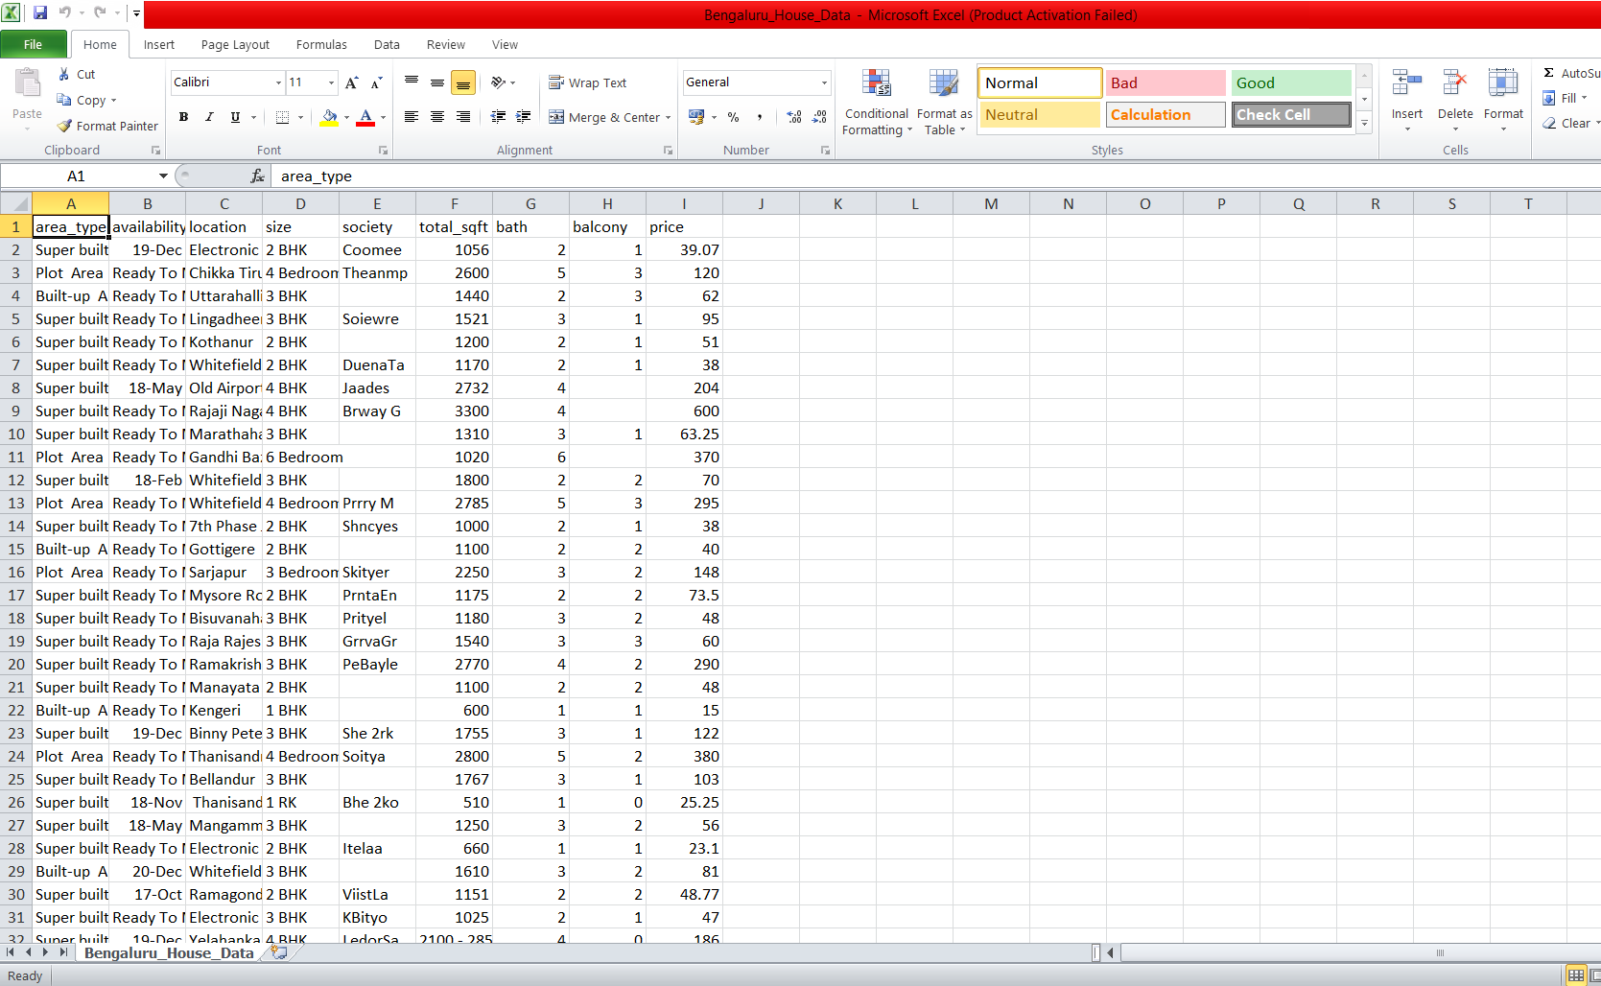
Dataset

Slide 5
1) Data Cleaning Steps
1) Dropping Unnecessary Columns
2) Filling missing values for bathroom column
3) Dropping remaining rows with missing values
4) Creating a bhk column to store number of bedrooms.
5) Cleaning Total_Sq_Ft column

Slide 6
2) Feature Engineering Steps
Create a new column price_per_sq_ft which will help in dimensionality reduction
Any location which has number of houses < 10, will be labelled as 'other’

Slide 7
3) Outlier Detection and Removal
Removal of Houses where price of 2bhk is greater than 3bhk for same location
Removing houses where number of bathrooms is greater than number of bedrooms + 2
Data visualization
Performing One Hot Encoding

Slide 8
4) Model Building
Split
Split the data into columns which are dependent and independent.
Split
Split the data into Training and Testing.
Build
Build the model.
Use
Use K Fold cross validation to measure accuracy

Slide 9
5) Testing different models and deciding upon the best one
Use GridSearchCV to test and compare different models.
Predict the Price.

Slide 10
A) Linear Regression
Linear regression attempts to model the relationship between two variables by fitting a linear equation to observed data. One variable is considered to be an explanatory variable, and the other is considered to be a dependent variable.
The most common method for fitting a regression line is the method of least-squares. This method calculates the best-fitting line for the observed data by minimizing the sum of the squares of the vertical deviations from each data point to the line
A linear regression line has an equation of the form Y = a + bX, where X is the explanatory variable and Y is the dependent variable. The slope of the line is b, and a is the intercept (the value of y when x = 0).

Slide 11
B) Decision Tree
Decision tree builds regression or classification models in the form of a tree structure. It breaks down a dataset into smaller and smaller subsets while at the same time an associated decision tree is incrementally developed. The final result is a tree with decision nodes and leaf nodes.
A decision node has two or more branches, each representing values for the attribute tested.
Leaf node represents a decision on the numerical target.
The topmost decision node in a tree which corresponds to the best predictor called root node.
Decision trees can handle both categorical and numerical data.

Slide 12
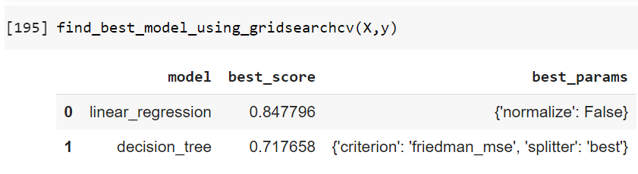
Comparison of Models

Slide 13
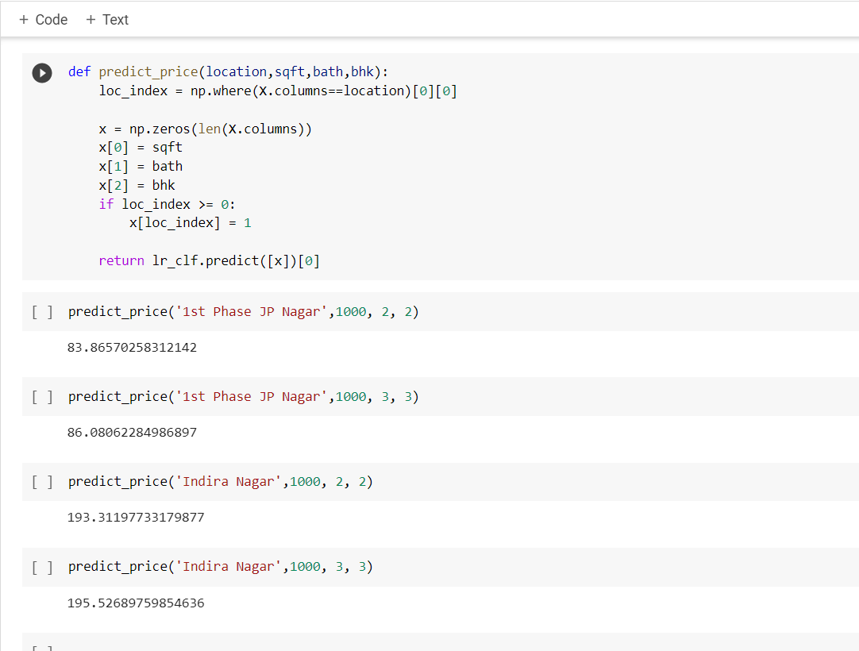
House Price Prediction

Slide 14
Implementation using Tool

Slide 15
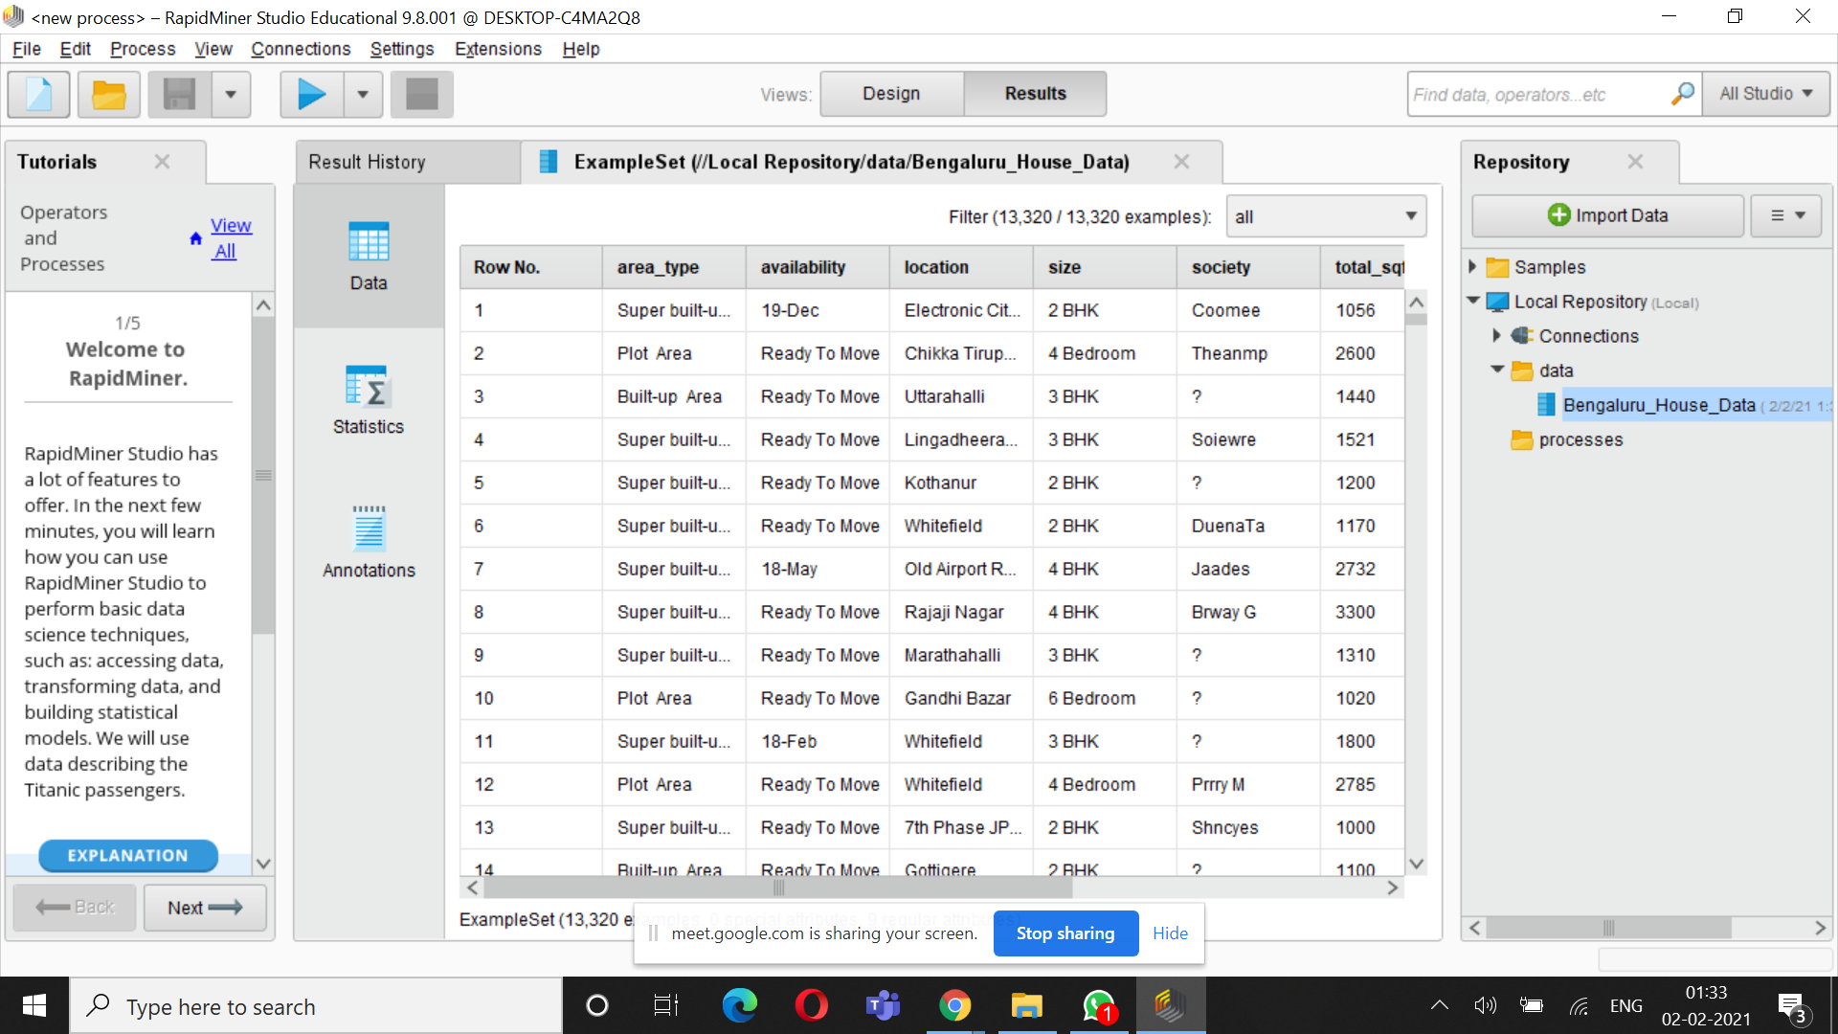

Slide 16
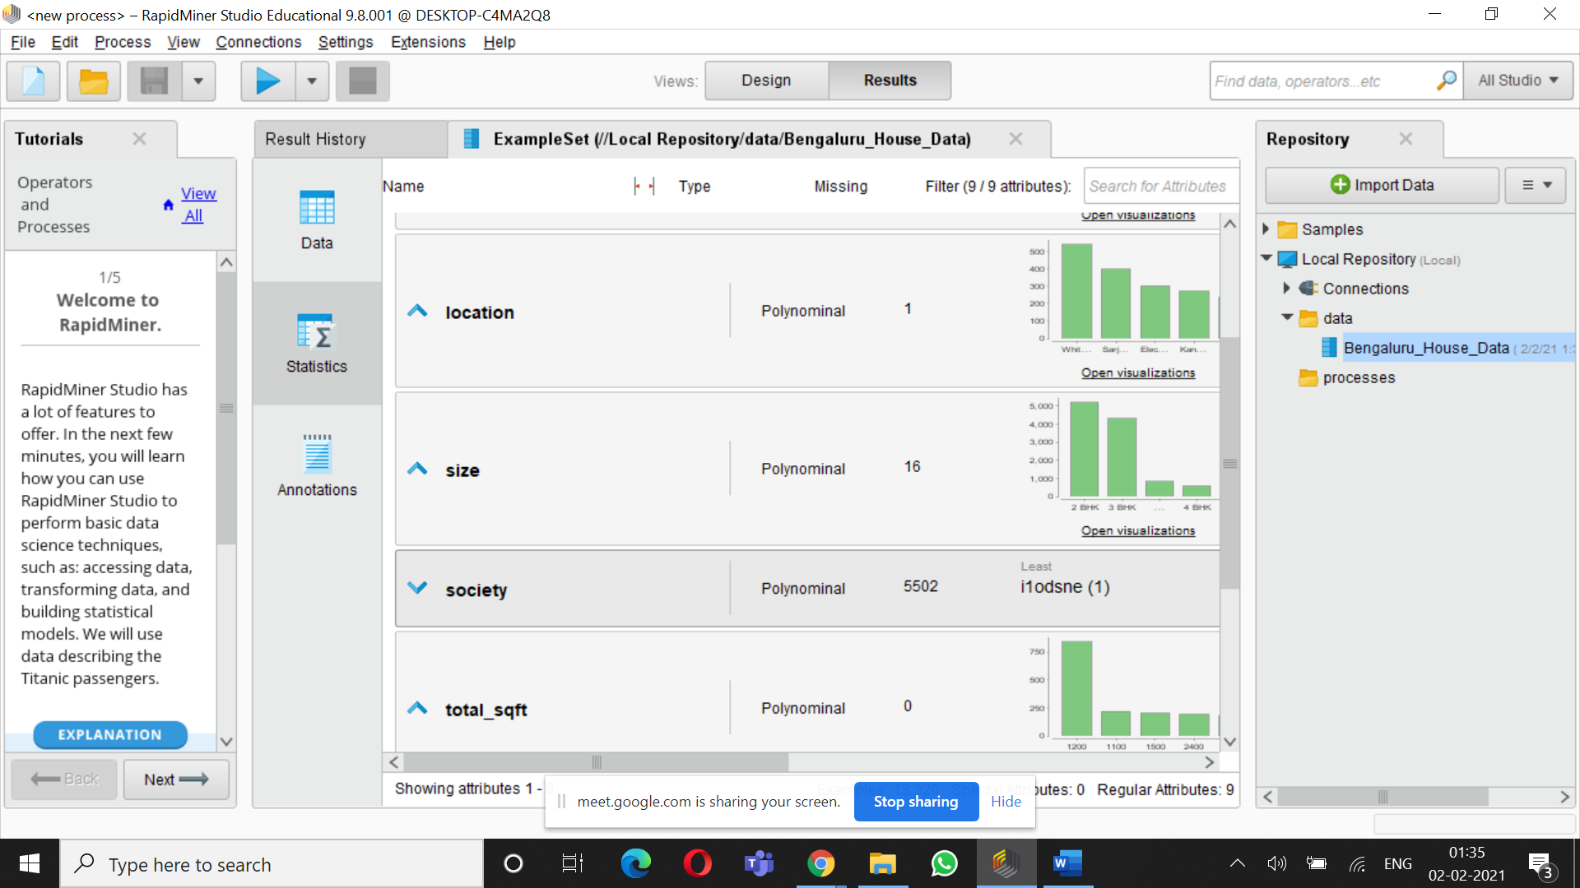

Slide 17
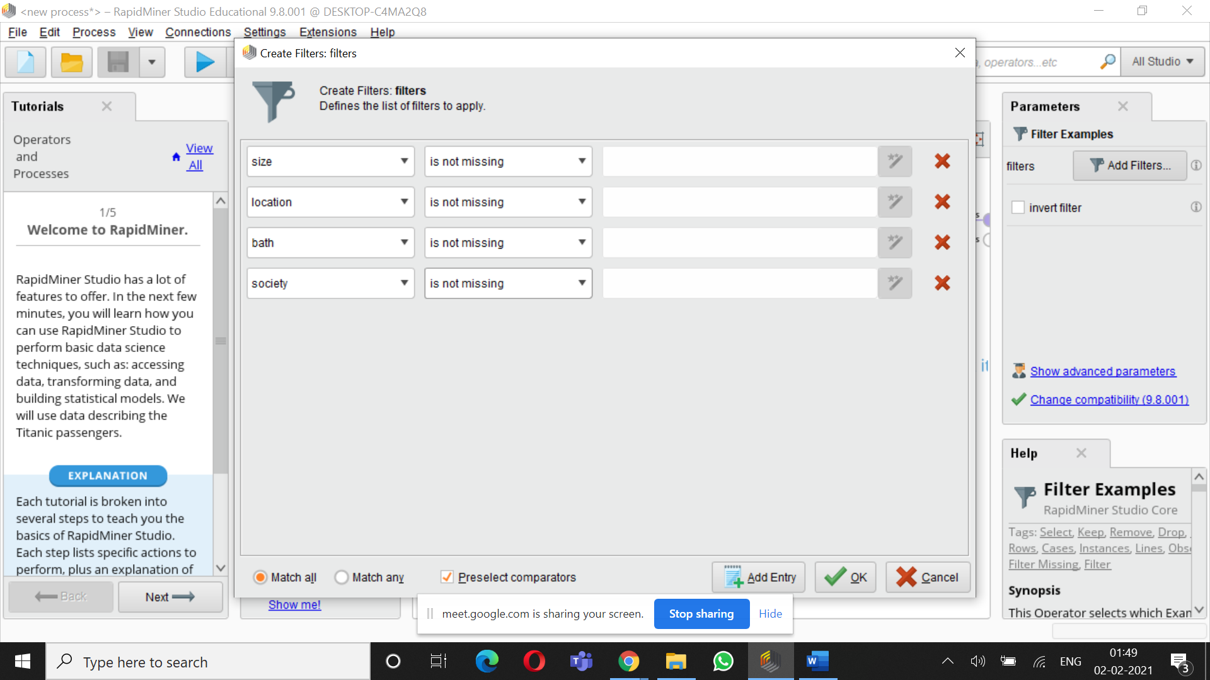

Slide 18
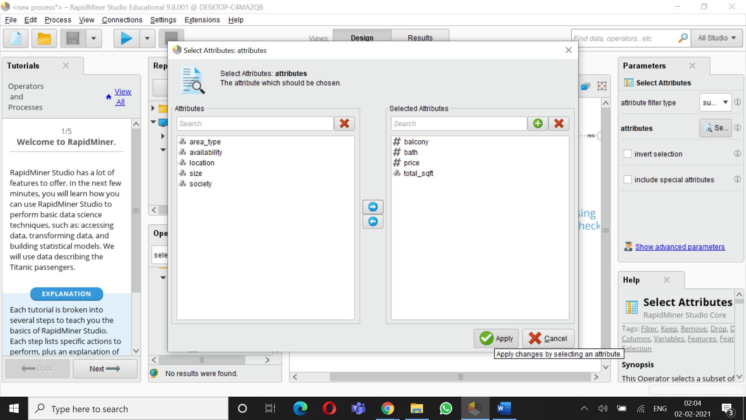

Slide 19
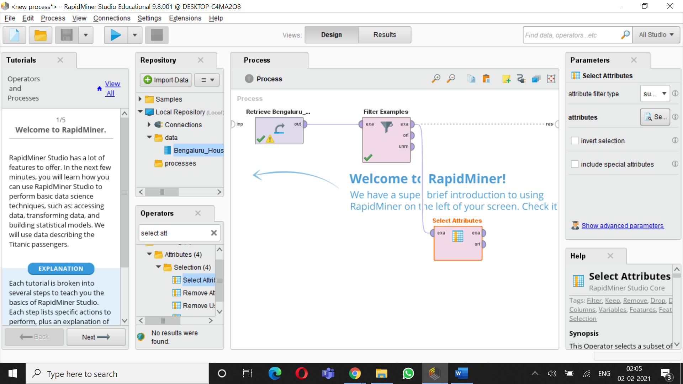

Slide 20
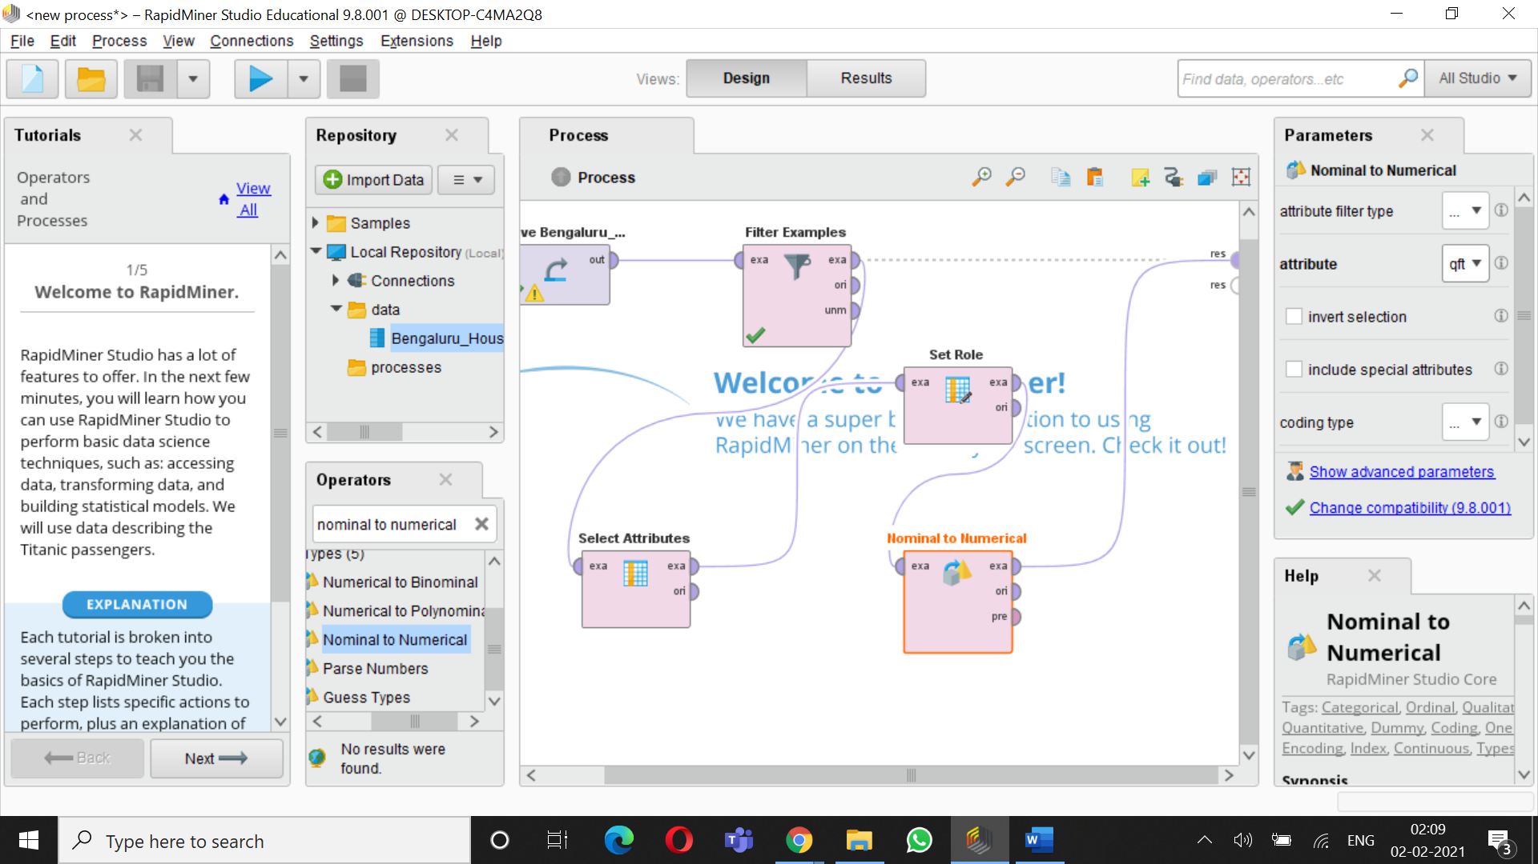

Slide 21
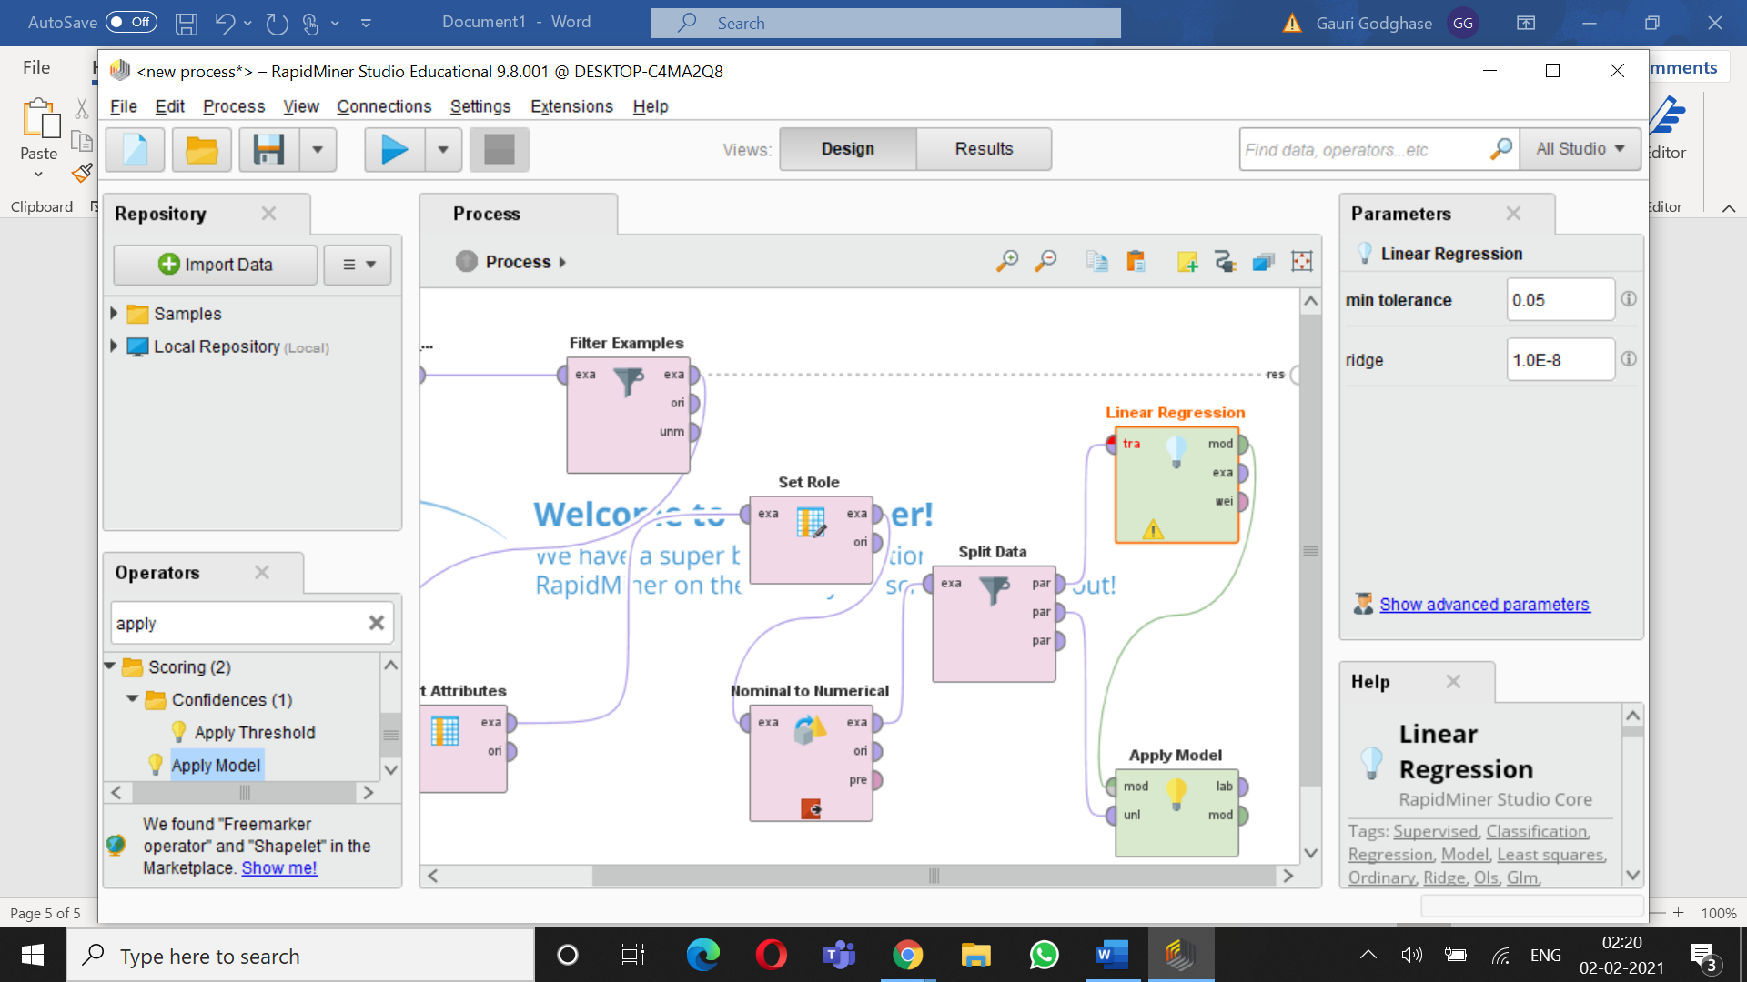

Slide 23
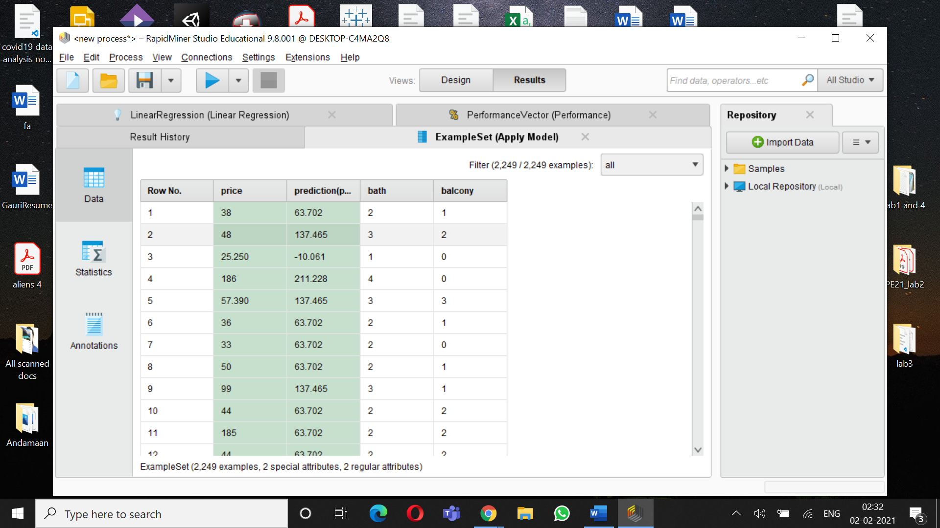

Slide 24
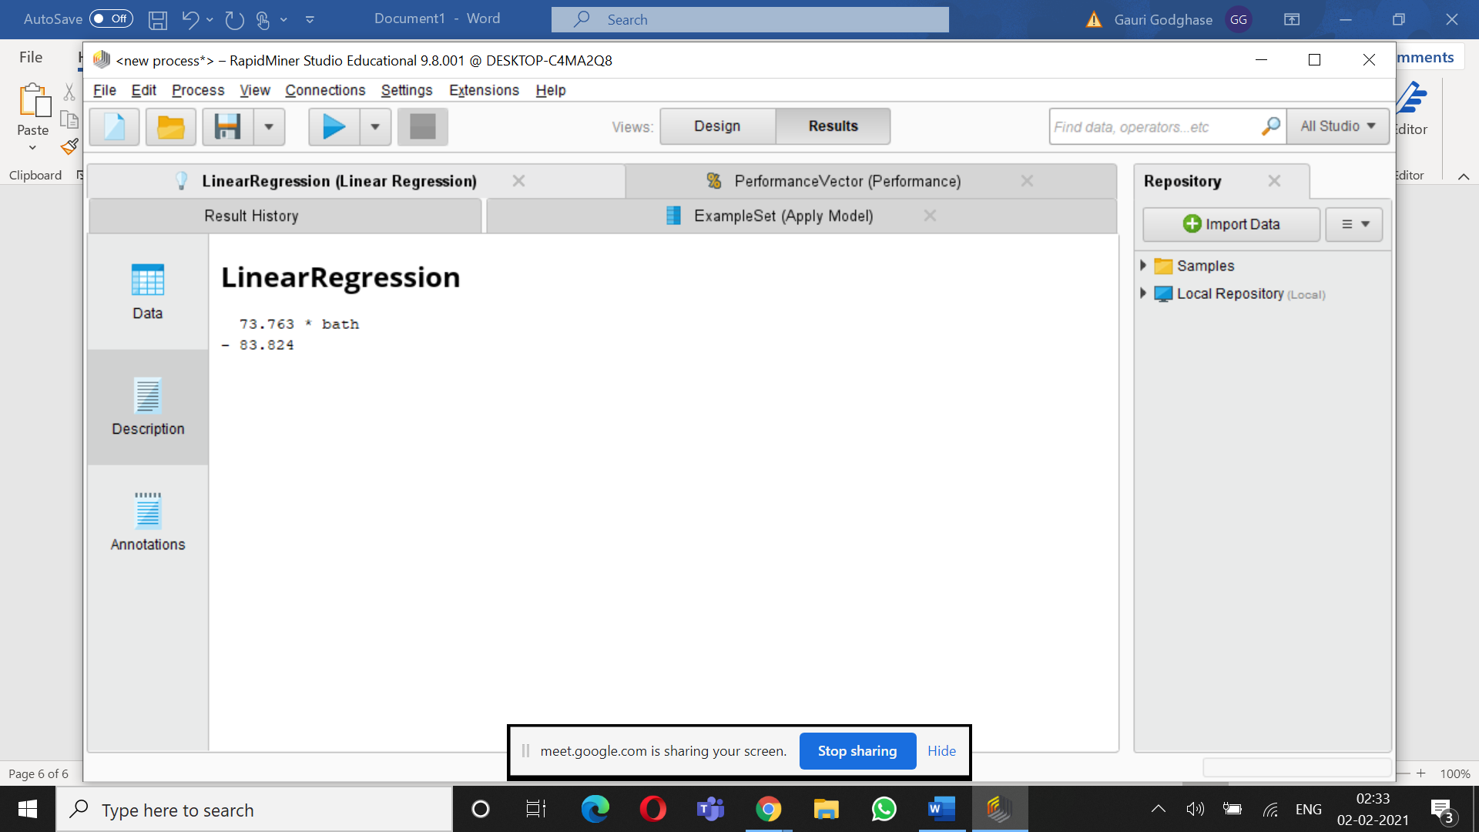

Slide 25
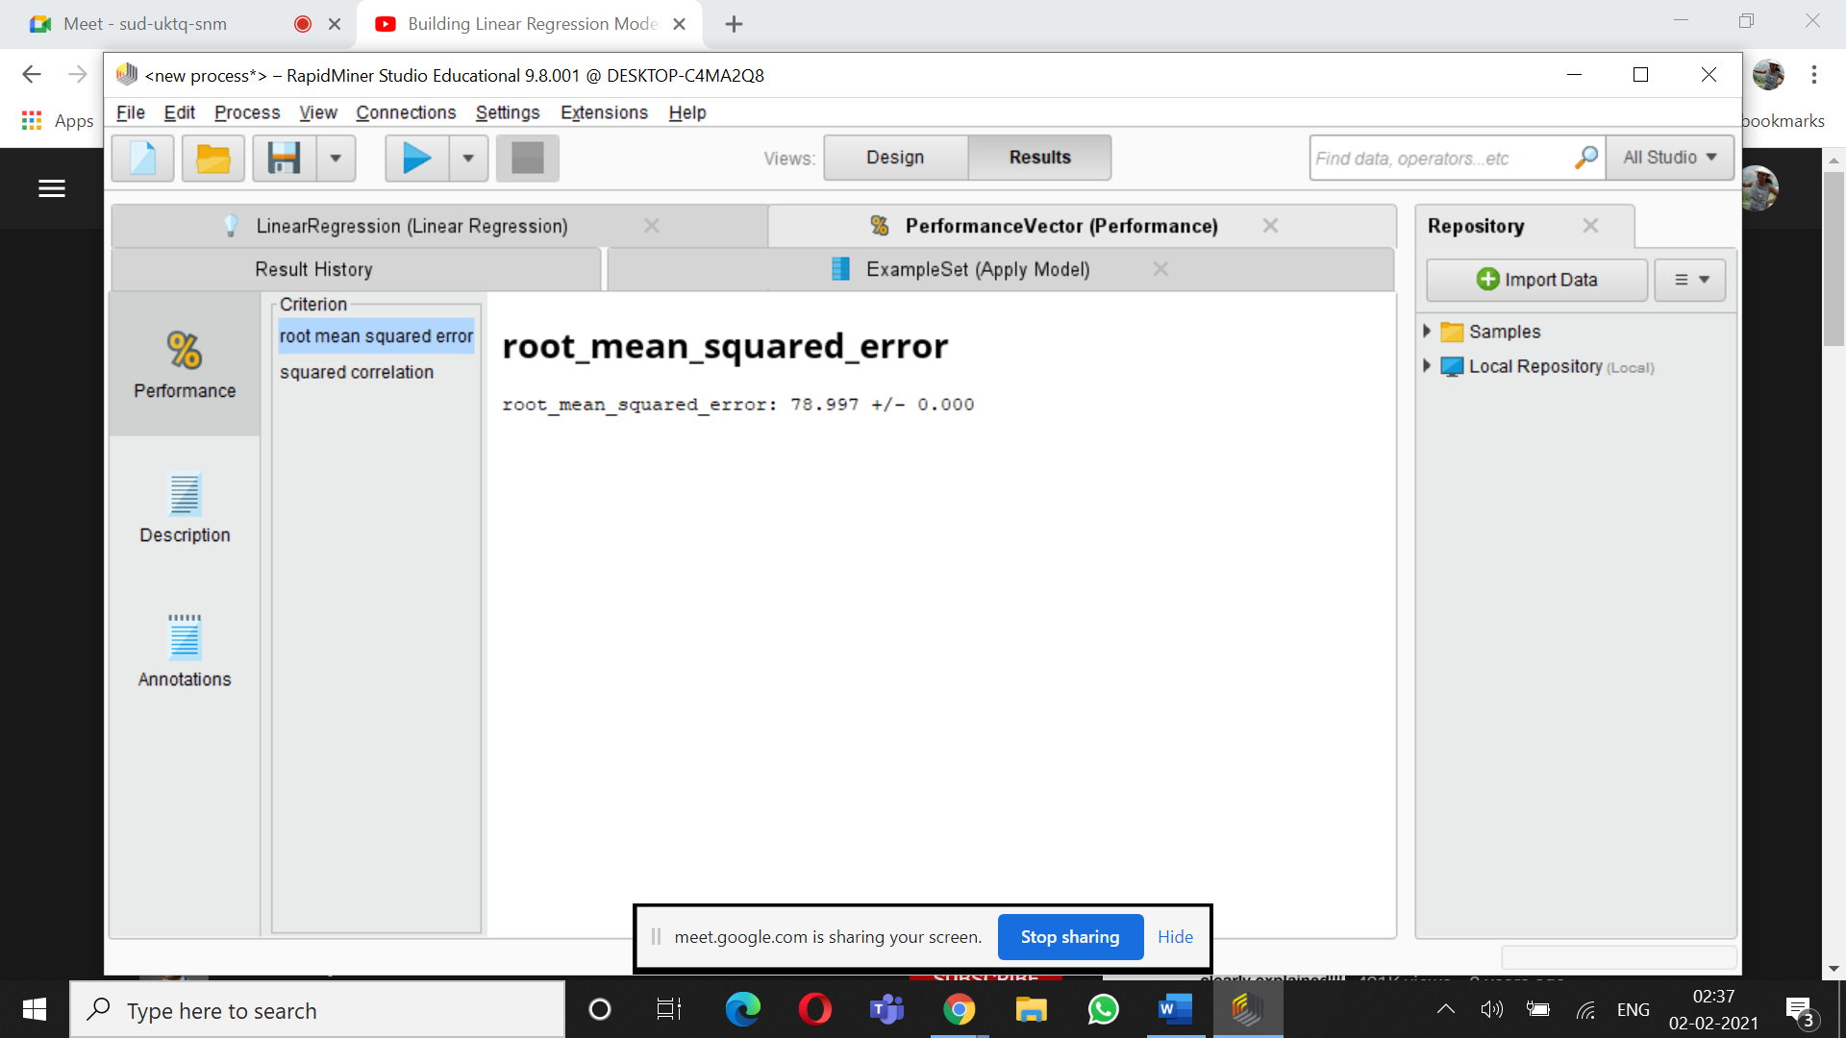

Slide 26
THANK YOU

